Slide 1
Optimization problem
Posts and Telecommunication Institute of Technology
Faculty of Information Technology 1
Mathematic discrete1
Ngo Xuan Bach
Dao Thi Thuy Quynh

Slide 2
Contents
Introduction
Brute force method
Branch and bound algorithm
Exercise

Slide 3
Introduce optimization problem
Counting problem : Count all combinatorial configurations that satisfy the constrains of problem. The desired solution is to build a formula to find out result of the problem.
Listing problem : Consider all combinatorial configurations that satisfy the constrains of the problem. The solution method usually returns a brute force algorithm (generation algorithm, backtracking algorithm,…)
Optimization problem : Among the combinatorial configurations that satisfy the requirements of problem, choose the solution with the best use value (optimize the objective function)

Slide 4
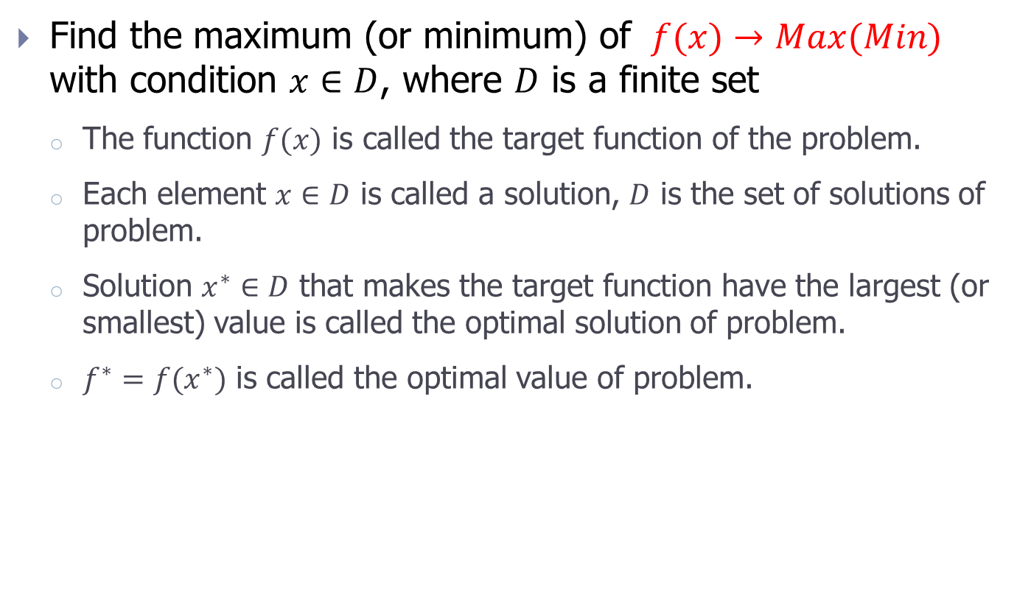
Optimization problem
Find the maximum (or minimum) of $f(x)→Max(Min)$ with condition $x∈D$, where $D$ is a finite set
The function $f(x)$ is called the target function of the problem.
Each element $x∈D$ is called a solution, $D$ is the set of solutions of problem.
Solution $x^{∗}∈D$ that makes the target function have the largest (or smallest) value is called the optimal solution of problem.
$f^{∗}=f(x^{∗})$ is called the optimal value of problem.

Slide 5

Example 1 (1/4)
Knapsack/Bag problem: An adventurer needs to carry a bag weighing no more than B. There are N items to bring. The i^{th} object has weight a_{i} , has using value c_{i} (i = 1, 2, …, N; a_{i}, c_{i} $∈Z+$). Find a way to put objects in the adventurer’s bag so that the total using value in the bag is maximum.

Slide 6
Example 1 (2/4)
Set of solutions: Each solution of the problem is a binary string of length N. In which, x_{i} = 1 corresponds to the object i put in the bag, x_{i} = 0 corresponds to the object I not put in the bag. The set of binary strings X = (x₁,…,x_{N}) must also satisfy the condition that the total weight does not exceed B. In other words, the set of solutions D of the problem is defined as the following formula:

Slide 7

Example 1 (3/4)
Target function: For each solution $X=(x1,...,x_{N})∈D$, we need to find the solution
$X^{∗}=\left(x_{1}^{∗},...,x_{N}^{∗}\right)$ such that the total using values in the bag is the maximum. The total using values of objects is determined by the following formula:

Slide 8

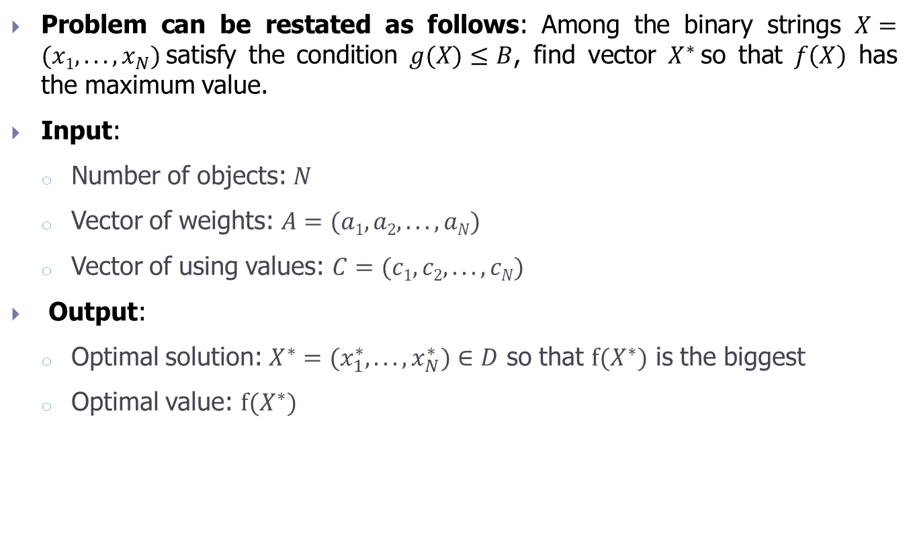
Example 1 (4/4)
Problem can be restated as follows: Among the binary strings $X=(x1,...,x_{N})$satisfy the condition $g(X)≤B$, find vector $X^{∗}$so that $f\left(X\right)$ has the maximum value.
Input:
Number of objects: $N$
Vector of weights: $A=(a1, a2, ..., aN)$
Vector of using values: $C=(c1, c2, ..., cN)$
Output:
Optimal solution: $X^{∗}=(x_{1}^{∗},...,x_{N}^{∗})∈D$ so that $f(X^{∗})$ is the biggest
Optimal value: $f(X^{∗})$
với $X∈D$

Slide 9

Example 2 (1/4)
The tourist problem: A tourist wants to visit N cities $T1, T2,...,T_{N}$. Starting in a certain city, the traveler wants to go through all the remaining cities exactly once and then return to the original city. Know that $cij$ is the cost of travelling from city $Ti$ to city $Tj$. Find a route for the traveler so that the total cost is the lowest.

Slide 10

Example 2 (2/4)
Set of solutions: Without limiting the generality of the problem, we fixed the starting point as the city $T1= 1$. Then, each journey of the traveler $T1T2... T_{N} T1$is considered as a permutation of $1,2,…, N$ is $X=(x1, x2,...,x_{N})$, where $x1=1$. So, the set of solutions $D$ of problem is the set of permutations $X=\left(x1, x2,...,x_{N}\right)$ with $x1=1$.

Slide 11
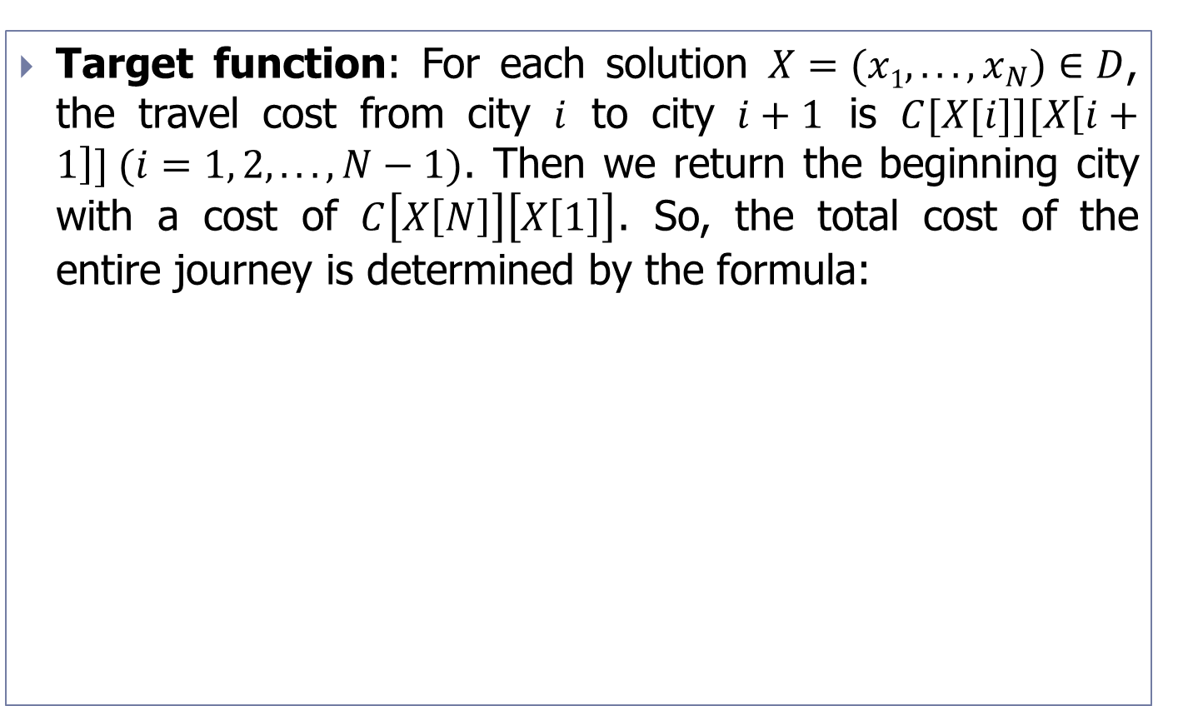
Example 2 (3/4)
Target function: For each solution $X=(x1,...,x_{N})∈D$, the travel cost from city $i$ to city $i+1$ is $C[X[i]][X\left[i+1\right]] (i=1, 2,..., N−1)$. Then we return the beginning city with a cost of $C\left[X\left[N\right]\right]\left[X\left[1\right]\right]$. So, the total cost of the entire journey is determined by the formula:

Slide 12

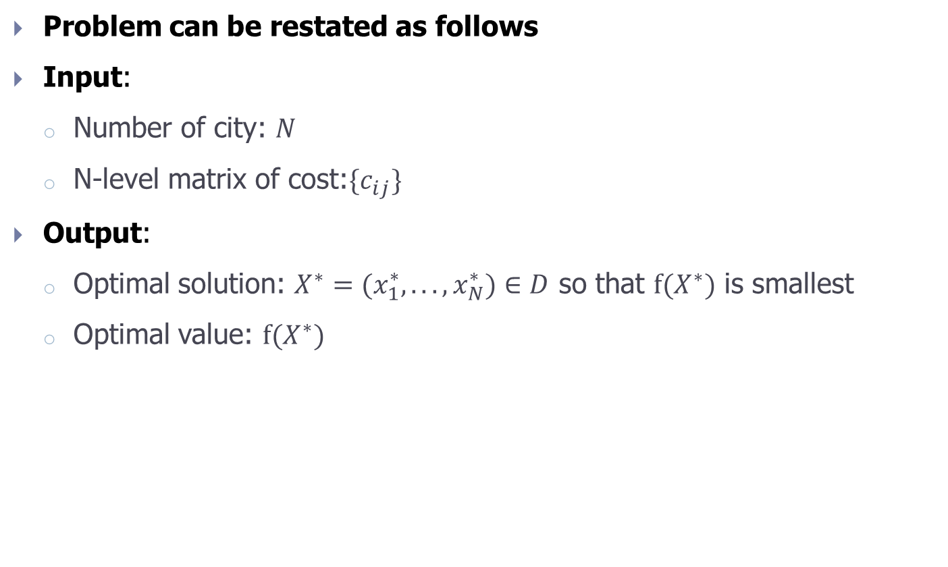
Example 2 (4/4)
Problem can be restated as follows
Input:
Number of city: $N$
N-level matrix of cost:$\{c_{ij}\}$
Output:
Optimal solution: $X^{∗}=(x_{1}^{∗},...,x_{N}^{∗})∈D$ so that $f(X^{∗})$ is smallest
Optimal value: $f(X^{∗})$
With $X∈D$

Slide 13
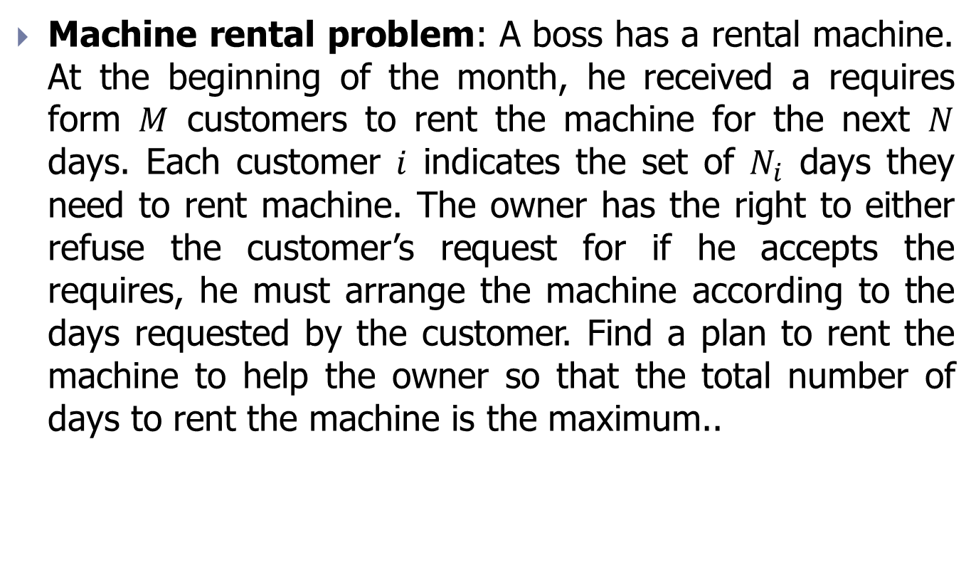
Example 3 (1/3)
Machine rental problem: A boss has a rental machine. At the beginning of the month, he received a requires form $M$ customers to rent the machine for the next $N$ days. Each customer $i$ indicates the set of $N_{i}$ days they need to rent machine. The owner has the right to either refuse the customer’s request for if he accepts the requires, he must arrange the machine according to the days requested by the customer. Find a plan to rent the machine to help the owner so that the total number of days to rent the machine is the maximum..

Slide 14
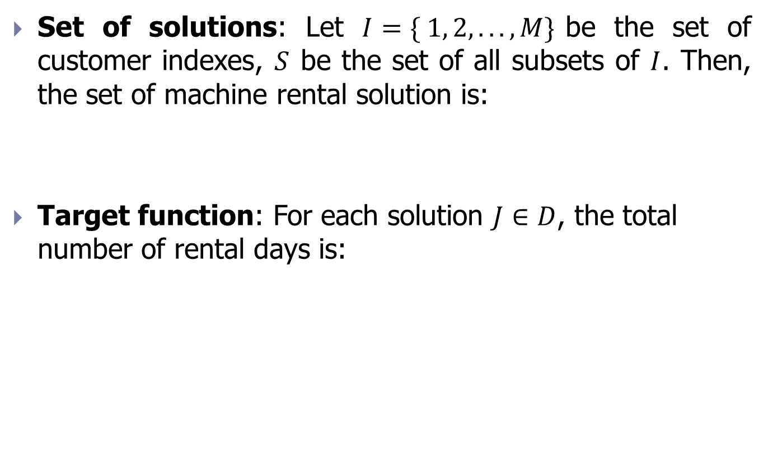
Example 3 (2/3)
Set of solutions: Let $I=\{ 1, 2, ..., M\}$be the set of customer indexes, $S$ be the set of all subsets of $I$. Then, the set of machine rental solution is:
Target function: For each solution $J∈D$, the total number of rental days is:

Slide 15

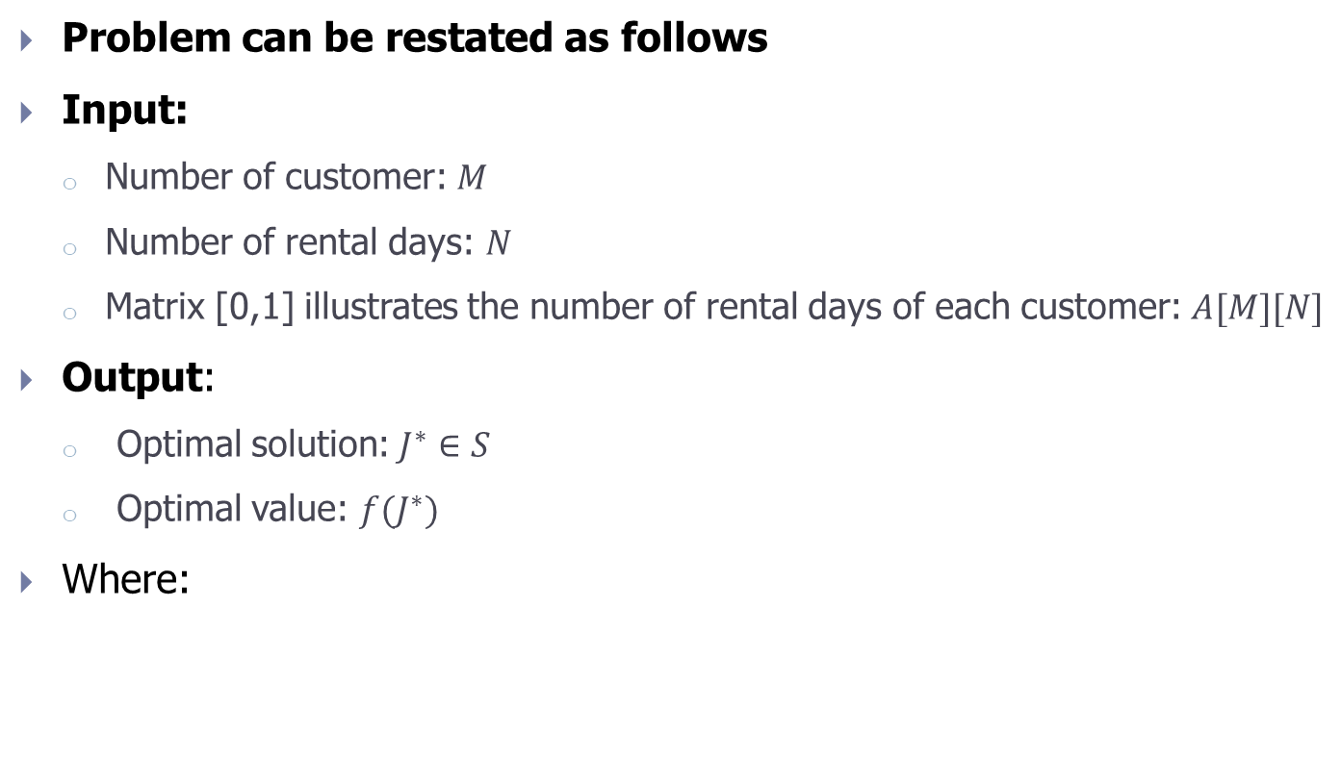
Example 3 (3/3)
Problem can be restated as follows
Input:
Number of customer: $M$
Number of rental days: $N$
Matrix [0,1] illustrates the number of rental days of each customer: $A[M][N]$
Output:
Optimal solution: $J^{∗}∈S$
Optimal value: $f(J^{∗})$
Where:
with $X∈D$

Slide 16

Example 4 (1/3)
Work assignment problem: A system consists of $N$ processes that perform $N$ parallel works. Knowing that each process can do $N$ works as above but with different costs. Knowing $c_{ij}$ is the time taken by process $i$ to do work $j$. Find a way to assign works to each process so that the total time to do $N$ works above is minimal.

Slide 17
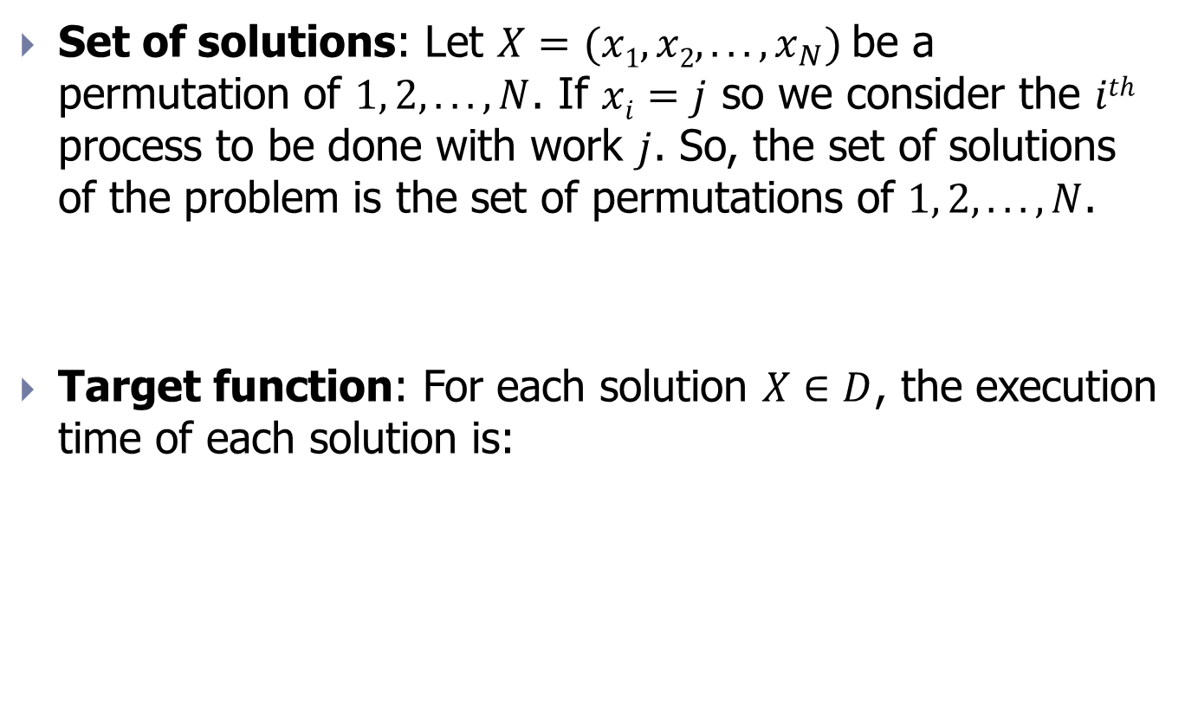
Example 4 (2/3)
Set of solutions: Let $X=(x1,x2,...,x_{N})$be a permutation of $1, 2,...,N$. If $xi=j$ so we consider the $ith$ process to be done with work $j$. So, the set of solutions of the problem is the set of permutations of $1, 2, ..., N$.
Target function: For each solution $X∈D$, the execution time of each solution is:

Slide 18

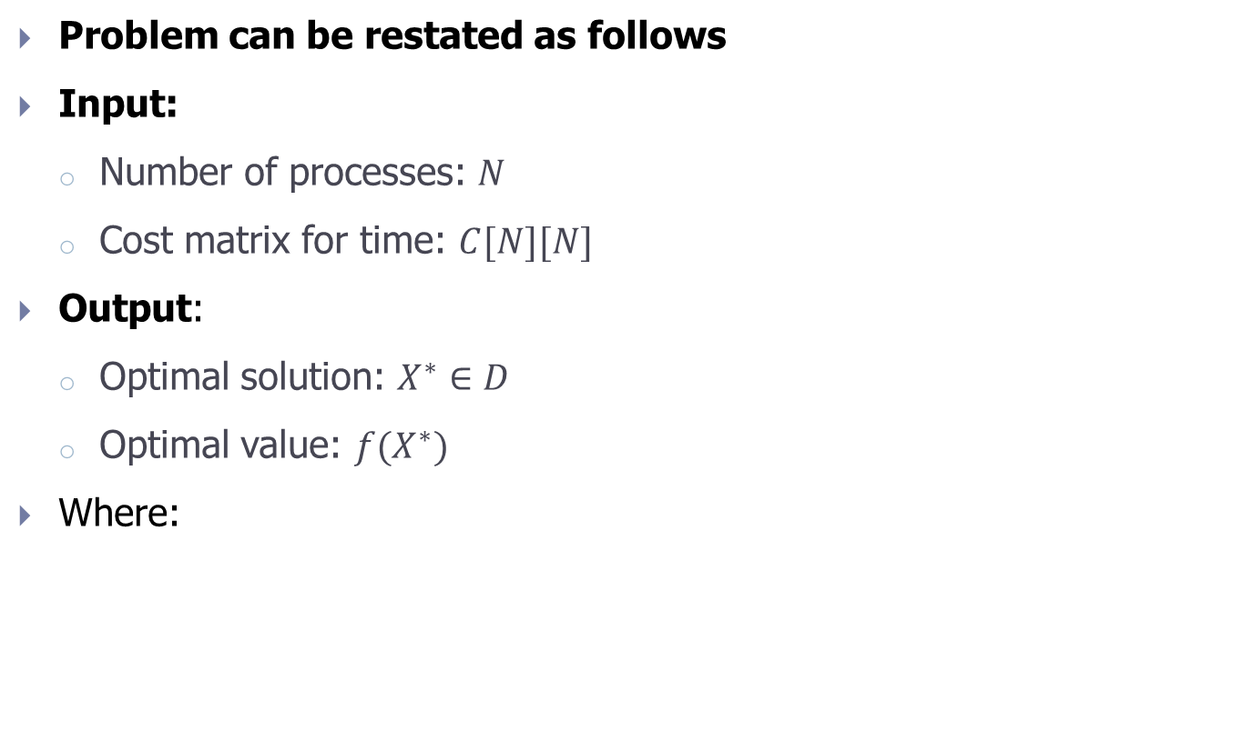
Example 4 (3/3)
Problem can be restated as follows
Input:
Number of processes: $N$
Cost matrix for time: $C[N][N]$
Output:
Optimal solution: $X^{∗}∈D$
Optimal value: $f(X^{∗})$
Where:
with $X∈D$

Slide 19
Contents
Introduction
Brute force algorithm
Branch and bound algorithm
Exercise

Slide 20


Brute force algorithm
Assume that $D$ is the set of solutions. We need to find$X^{∗}∈D$ so that $f(X^{∗})max⁡(min)$. Brute force algorithm is carried out as follows:
Step 1 (Init):
$XOPT=∅$; //Optimal solution
$FOPT=−  (+ );$//Optimal value
Step 2 (Loop):
for ($X∈D$){ //Each element from set of solutions
$S=f(X$);// compute value of target function for solution X
if ( $FOPT<S$ ) { //Update optimal solution
$FOPT = S$; //Update optimal value
$XOPT = X$;// New optimal solution
}
}
Step 3 (Return result):
Return($XOPT, FOPT$);

Slide 21
Features of Brute force algorithm
Advantages:
Simple and easy to implement
Can be performed on any optimization problem
Disadvantages:
Large computational cost

Slide 22
Exercise
Write programs to solve the following problems on a computer using the Brute force algorithm
The bag problem
The tourist problem
The machine rental problem
The work assignment problem

Slide 23
Contents
Introduction
Brute force algorithm
Branch and bound algorithm
Exercise

Slide 24
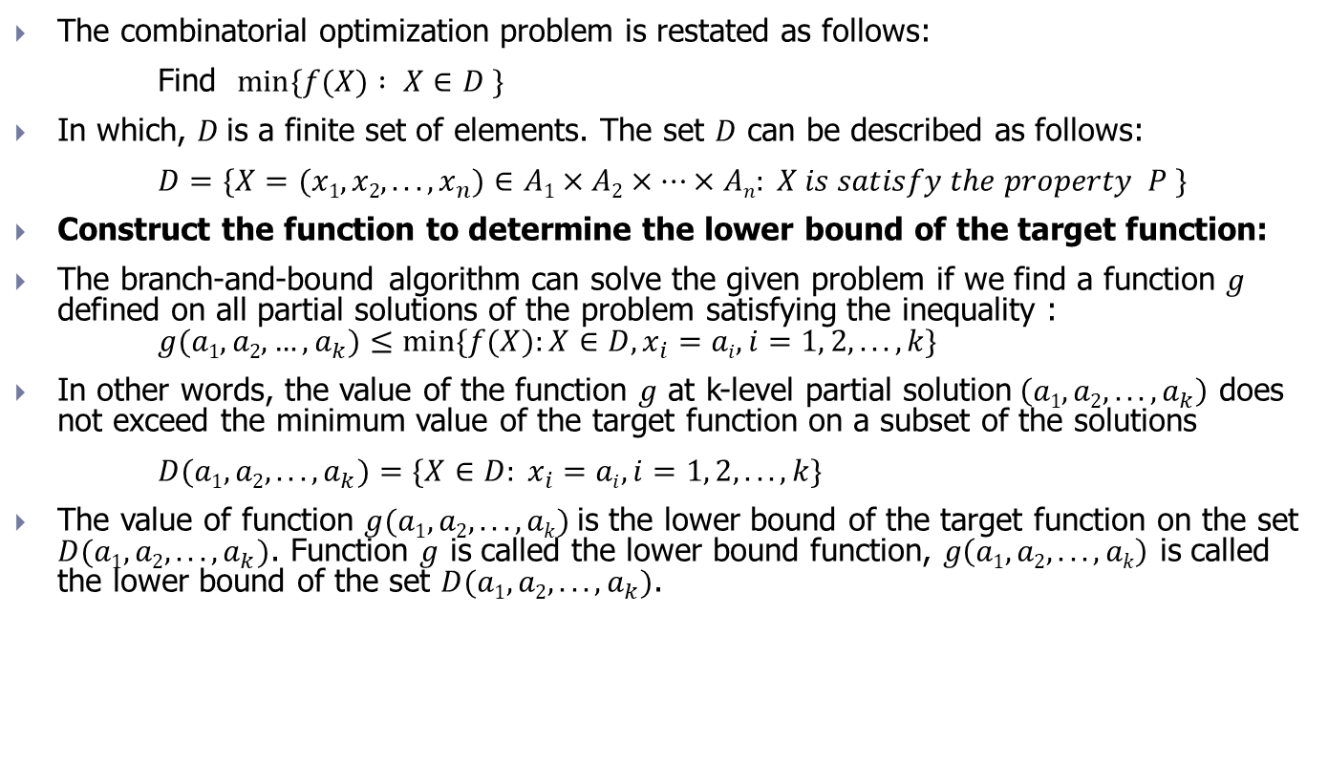
Branch-and-bound algorithm
The combinatorial optimization problem is restated as follows:
Find $min⁡\{f(X) : X∈D \}$
In which, $D$is a finite set of elements. The set $D$ can be described as follows:
$D=\{X=(x1, x2,...,x_{n})∈A1×A2×…×An: X is satisfy the property P \}$
Construct the function to determine the lower bound of the target function:
The branch-and-bound algorithm can solve the given problem if we find a function $g$ defined on all partial solutions of the problem satisfying the inequality : $g(a1, a2, …,a_{k})≤min⁡\{f(X):X∈D, x_{i}=ai, i=1, 2,...,k\}$
In other words, the value of the function $g$ at k-level partial solution$\left(a1, a2,...,a_{k}\right)$ does not exceed the minimum value of the target function on a subset of the solutions
$D(a1, a2,...,a_{k})=\{X∈D: x_{i}=ai, i=1, 2, ..., k\}$
The value of function $g(a1, a2, ...,ak)$is the lower bound of the target function on the set $D(a1, a2,...,a_{k})$. Function $g$ is called the lower bound function, $g\left(a1, a2, ...,ak\right)$ is called the lower bound of the set $D(a1, a2,...,a_{k})$.

Slide 25
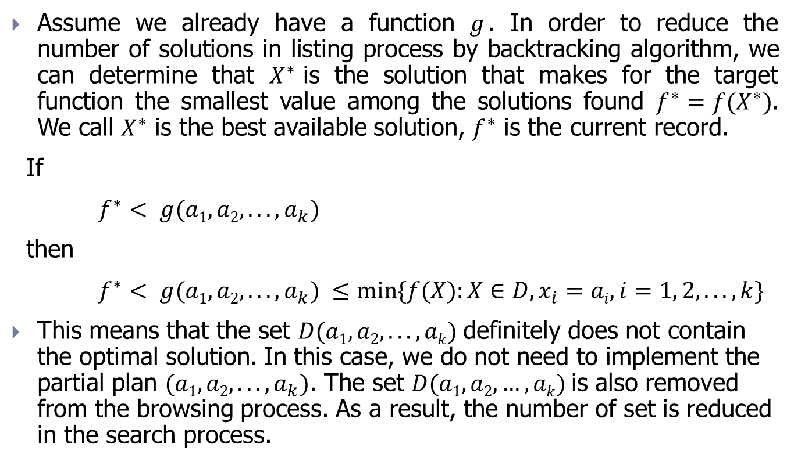
Limiting solution
Assume we already have a function $g$. In order to reduce the number of solutions in listing process by backtracking algorithm, we can determine that $X^{∗}$is the solution that makes for the target function the smallest value among the solutions found $f^{∗}=f(X^{∗})$. We call $X^{∗}$ is the best available solution, $f^{∗}$ is the current record.
If
$f^{∗}< g(a1, a2,...,a_{k})$
then
$f^{∗}< g(a1, a2,...,a_{k}) ≤min⁡\{f(X):X∈D, x_{i}=ai, i=1, 2, ...,k\}$
This means that the set $D(a1, a2,..., ak)$definitely does not contain the optimal solution. In this case, we do not need to implement the partial plan $(a1,a2,...,a_{k})$. The set $D(a1,a2,…,ak)$is also removed from the browsing process. As a result, the number of set is reduced in the search process.

Slide 26

Branch-and-bound algorithm (pseudo code)
Branch_And_Bound algorithm ($k$) {
for ($ak∈Ak$){
if(<accept $ak$>){
$xk=ak$;
if ( $k==n$)
<update optimum>;
else if ( $g\left(a1, a2,...,a_{k}\right)<f^{∗}$)
Branch_And_Bound ($k+1$) ;
}
}
}

Slide 27
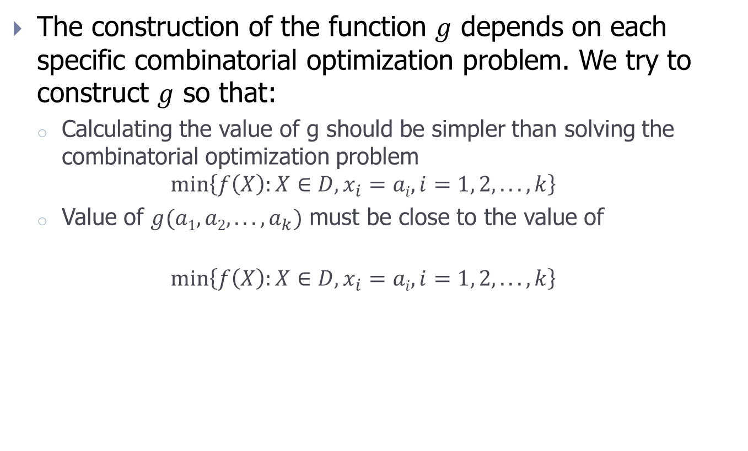

Construct the function $g$
The construction of the function $g$ depends on each specific combinatorial optimization problem. We try to construct $g$ so that:
Calculating the value of g should be simpler than solving the combinatorial optimization problem
$$\min\left\{f\left(X\right):X∈D, x_{i}=ai, i=1, 2, ...,k\right\}$$
Value of $g(a1, a2,...,a_{k})$ must be close to the value of
$$\min\left\{f\left(X\right):X∈D, x_{i}=ai, i=1, 2, ...,k\right\}$$
These two requirements are often contradictory and difficult to satisfy at the same time in reality

Slide 28
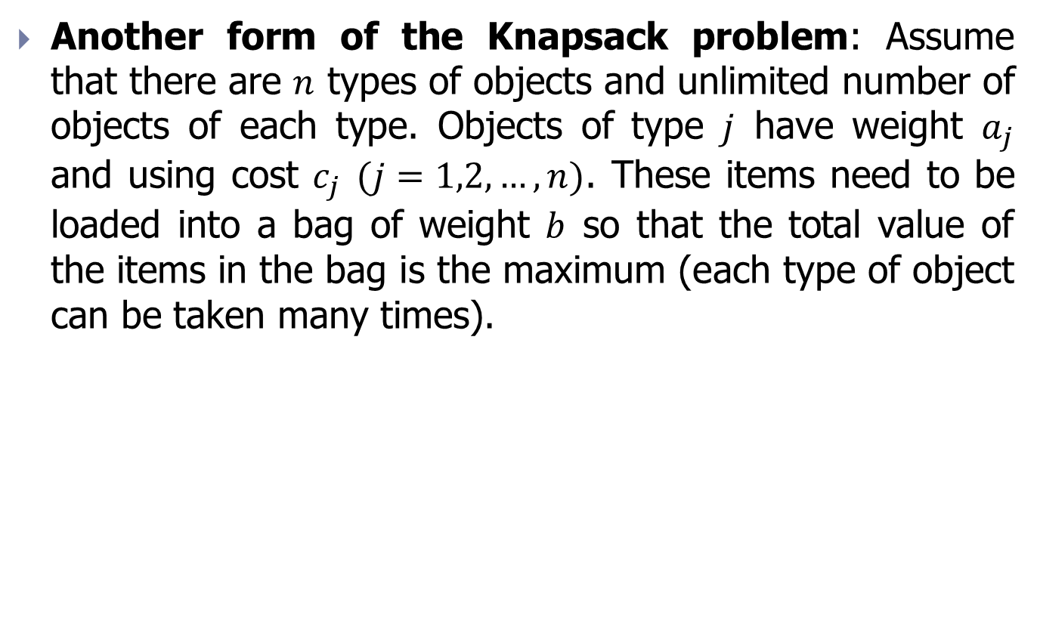
Solving the Bag problem by branch-and-bound algorithm (1/4)
Another form of the Knapsack problem: Assume that there are $n$ types of objects and unlimited number of objects of each type. Objects of type $j$ have weight $a_{j}$ and using cost $c_{j}$ $(j=1,2,…,n)$. These items need to be loaded into a bag of weight $b$ so that the total value of the items in the bag is the maximum (each type of object can be taken many times).

Slide 29

Solving the Bag problem by branch-and-bound algorithm (2/4)
The bag problem can be generalized as follows: Find the maximum value of the targe function $f(X)$ with $X∈D$. In which, $f(X)$ is determined as below:
Example of a bag problem:

Slide 30

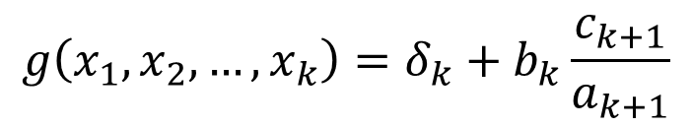
Solving the Bag problem by branch-and-bound algorithm (3/4)
Step 1: Arrange objects so that
Step 2 (Loop): loop over k-level partial problems:
Using values of k objects in bag:
Remaining weight of bag:
Upper bound of the k-level partial solution:
Step 3 (Return result): Optimal solution and optimal value
$$δ_{k}=\sum_{i=1}^{k}{c_{i}x_{i}}$$
$${g\left(x_{1},x_{2},…,x_{k}\right)=δ}_{k}+b_{k}\frac{c_{k+1}}{a_{k+1}}$$

Slide 31



Solving the Bag problem by branch-and-bound algorithm (4/4)
Branch-and-bound algorithm (k) {
for (j =$\left\lfloor b_{k}/a_{k}\right\rfloor$; j>=0; j--){
x[k] = j;
if (k==n) < Record >;
else if (δ_{k} + (c_{k+1}*b_{k})/a_{k+1} >FOPT)
Branch_And_Bound(k+1);
}
}
$$δ_{k}=δ_{k}+c_{k}x_{k};$$
$$δ_{k}=δ_{k}−c_{k}x_{k};$$

Slide 32
Example 5 (1/2)

Slide 33
Example 5 (2/2)
FOPT=-∞
X₁=1
X₁=0
δ₁=10;
b₁=3;g₁=15
(0);δ₁=0;
b₁=8;g₁=40/3
X₂=1
X₂=0
(1,1);δ₂=15;
b₂=0;g₂=15;
(1,0);δ₂=10;
b₂=3;g₂=14.5;
X₃=0
(1,1,0);δ₃=15;
b₃=0;g₃=15;
Loại vì g<15
X₄=0
(1,1,0,0);δ₄=15;
b₄=0;f*=15;

Slide 34

Exercise 1
Apply branch-and-bound algorithm to solve the Knapsack/ Bag problem, specify the result for each step:
$f\left(X\right)=7x_{1}+4x_{2}+{2x}_{3}→max$
$$4x_{1}+3x_{2}+{2x}_{3}≤6$$
$${ x}_{1},x_{2},x_{3}∈\{0,1\}.$$

Slide 35

Exercise 2
Apply branch-and-bound algorithm to solve the Tourist problem, specify the result for each step:
$f\left(X\right)=5x1 +x2 +8x3 +x4 → max$,
$$4x1 + 2x2 + 7x3 + x4 ≤ 9,$$
$x_{1},x_{2},x_{3},x4∈\{0,1\}.$

Slide 36

Solve the tourist problem by branch-and-bound algorithm (1/4)
The tourist problem can be generalized as follows: Find the minimum value of the target function $f(X)$ with $X∈D$. In which, $f(X)$ is determined as below:
Example of cost matrix
0 | 3 | 14 | 18 | 15
3 | 0 | 4 | 22 | 20
17 | 9 | 0 | 16 | 4
6 | 3 | 7 | 0 | 12
9 | 15 | 11 | 5 | 0

Slide 37
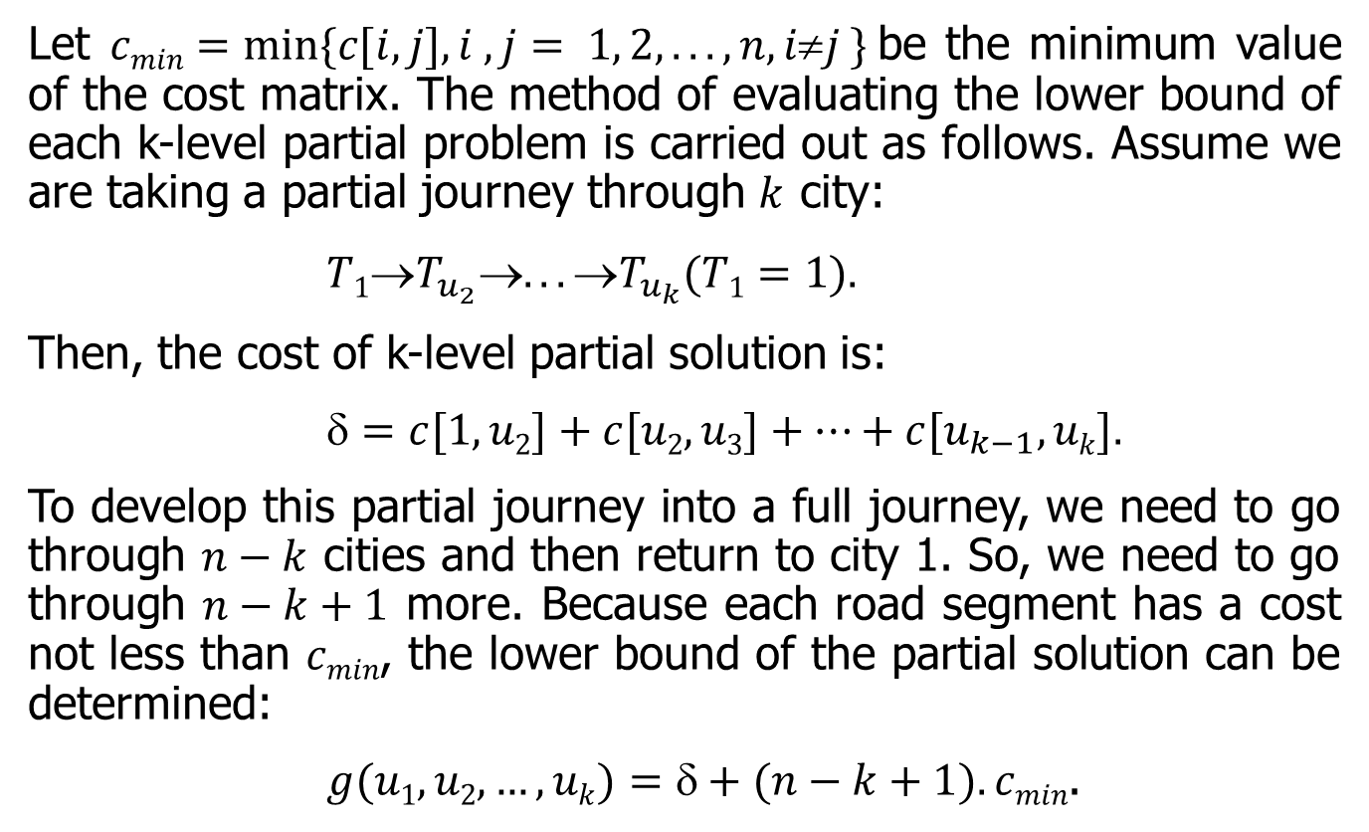
Solve the tourist problem by branch-and-bound algorithm (2/4)
Let $cmin=min⁡\{c[i, j], i , j= 1, 2,..., n, ij \}$be the minimum value of the cost matrix. The method of evaluating the lower bound of each k-level partial problem is carried out as follows. Assume we are taking a partial journey through $k$ city:
$T1T_{u_{2}}... T_{u_{k}}(T1=1).$
Then, the cost of k-level partial solution is:
$=c[1, u2]+c[u2,u3]+…+c[u_{k−1}, uk].$
To develop this partial journey into a full journey, we need to go through $n−k$ cities and then return to city 1. So, we need to go through $n−k+1$ more. Because each road segment has a cost not less than $cmin$, the lower bound of the partial solution can be determined:
$g(u1,u2,…,uk)=+(n−k+1).cmin$.

Slide 38
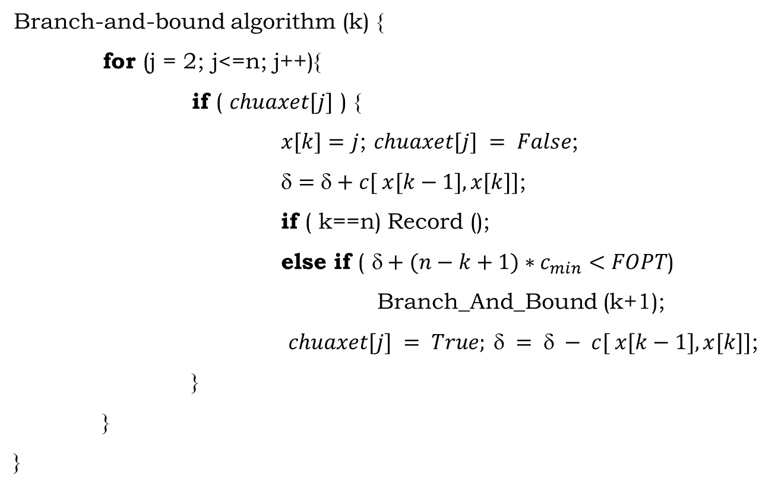
Solve the tourist problem by branch-and-bound algorithm (3/4)
Branch-and-bound algorithm (k) {
for (j = 2; j<=n; j++){
if ( $chuaxet[j]$ ) {
$x[k]=j$; $chuaxet[j] = False$;
$=+c[ x[k−1], x[k]]$;
if ( k==n) Record ();
else if ( $+(n−k+1)∗c_{min}<FOPT$)
Branch_And_Bound (k+1);
$chuaxet[j] = True;  =  − c[ x[k−1], x[k]]$;
}
}
}

Slide 39
Solve the tourist problem by branch-and-bound algorithm (4/4)
FOPT= +∞
(1,2), δ=3, g=15
(1,3), δ=14, g=26
(1,4), δ=18, g=30
(1,5), δ=15, g=27
(1,2,3), δ=7, g=16
(1,2,4), δ=25, g=34
(1,2,5), δ=23, g=32
(1,2,3,4), δ=23, g=29
Discarded because it has a larger lower bound 22
(1,2,3,5), δ=11, g=17
(1,2,3,4,5), δ=35, g=38
Journey :1,2,3,5,4,1
Cost: 22
(1,2,3,5,4), δ=16, g=19
Hành trình:1,2,3,4,5,1
Chi phí: 44

